Slide 1
Software Engineering I
Session 8: Software Development Process – The design process
Dr. Adrian Als & Dr. Paul Walcott
Department of Computer Science, Mathematics and Physics
University of the West Indies, Cave Hill Campus
Barbados
NEXT

Slide 2
Session Objectives
On successful completion of this session a student will be able to:
  Discuss the properties of good software design
  Review and critique the quality of a software design
  Choose appropriate metrics for the design phase
  Apply appropriate design phase testing strategies

Slide 3
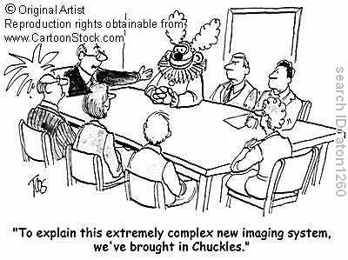

Slide 4
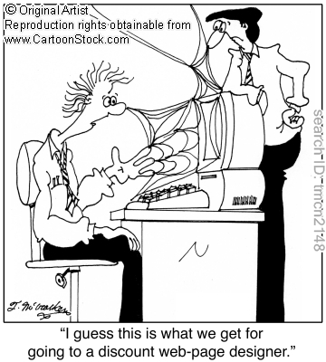

Slide 5
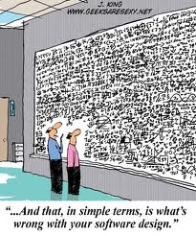

Slide 6
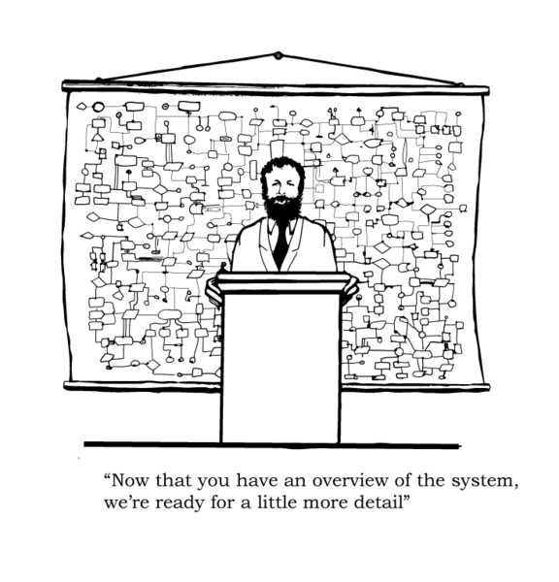

Slide 7
Introduction
In this session we will be exploring some of the theoretical aspects of the design phase.

Slide 8
What is a Software Design?
A software design is a meaningful engineering representation of some software product that is to be built.
  A design can be traced to the customer's requirements and can be assessed for quality against a set of predefined criteria.
Notes:
What is it? What are the properties of if? (it = design)
The design phase consists largely of three activities: Architectural design, detailed design and design testing. The input into the design phase is the specification document, a description of what the product is suppose to do. The output is the design document which describes how the produce is to achieve its objective(s). Essentially each design model produces a product which is placed in the design document.
The two design activities listed above essentially form four main areas of concern for designers are: data design, architectural design, interface design and component design.
Quality refers to both internal (modularisation etc… visible to other s/w professionals) and external (visible to the user).

Slide 9
What is a Software Design Cont’d?
  During the design phase the software specifications are transformed into design models that describe the details of the data structures, system architecture, interfaces, and components.
  Each design product is reviewed for quality before moving to the next phase of software development.
Notes:
What is it? What are the properties of if? (it = design)
The design phase consists largely of three activities: Architectural design, detailed design and design testing. The input into the design phase is the specification document, a description of what the product is suppose to do. The output is the design document which describes how the produce is to achieve its objective(s). Essentially each design model produces a product which is placed in the design document.
The two design activities listed above essentially form four main areas of concern for designers are: data design, architectural design, interface design and component design.
Quality refers to both internal (modularisation etc… visible to other s/w professionals) and external (visible to the user).

Slide 10
Why is Software Design necessary?
This is the only phase in which the customer’s requirements can be accurately translated into a finished software product or system
  software design serves as the foundation for all software engineering steps that follow regardless of which process model is being employed.
Notes:
In many s/w development projects, software design is still an adhoc process. Normally the requirements, usually expressed in natural language, are used to make an informal design. Coding commences and the design is modified as the system is being implemented. Typically, there is little or no formal change control or design management.. Thus, by the time the implementation is complete, the design has usually changed so much from the initial specifications that the original design document is an incorrect and incomplete description of the system.
The design process is very important. From a practical standpoint, as a labourer, one would not attempt to build a house w/o an approved blueprint and the risk structural integrity and customer satisfaction. In the same manner, the approach to building software is no different. Again the emphasis is on quality.

Slide 11
Why is Software Design necessary Cont’d?
Without a proper design we risk building an unstable system:
  one that may be difficult to test
  one whose quality cannot be assessed until late in the software process
Notes:
In many s/w development projects, software design is still an adhoc process. Normally the requirements, usually expressed in natural language, are used to make an informal design. Coding commences and the design is modified as the system is being implemented. Typically, there is little or no formal change control or design management.. Thus, by the time the implementation is complete, the design has usually changed so much from the initial specifications that the original design document is an incorrect and incomplete description of the system.
The design process is very important. From a practical standpoint, as a labourer, one would not attempt to build a house w/o an approved blueprint and the risk structural integrity and customer satisfaction. In the same manner, the approach to building software is no different. Again the emphasis is on quality.

Slide 12
Design Specification Models
Data design - created by transforming the analysis information model (data dictionary and ERD) into data structures required to implement the software
Notes:
Notes for Slide 4
Analysis modelliing (AM) uses a combination of text and diagrammatic forms to depict the requirements for data, function and behaviour in a form that is relatively easy to understand, and more importantly, straightforward to review for correctness, completeness and consistency.
AM gets away from the 1D viewpoint of plain text to present a 3D representation of the requirements so that the probability of finding errors increases.
AM involves:
Data modelling – defines data objects (MAN etc…) attributes (age,height etc…) and relationships (Man own Car) using ERDs.
Functional modelling – describes how information is transformed within each module using DFDs
Behavioural Modelling – Depicts the impact of events on the system using SFDs. In essence behavioural models are used to describe the overall behaviour of the system and may use both DFDs and State flow diagrams.

Slide 13
Design Specification Models Cont’d
Architectural design - defines the relationships among the major structural elements of the software, it is derived from the system specification, the analysis model, and the subsystem interactions defined in the analysis model (DFD)

Slide 14
“Software architecture encompasses the set of significant decisions about the organization of a software system including the selection of the structural elements and their interfaces by which the system is composed; behavior as specified in collaboration among those elements; composition of these structural and behavioral elements into larger subsystems; and an architectural style that guides this organization....”
Philippe Kruchten, Grady Booch, Kurt Bittner, and Rich Reitman definition based on Mary Shaw and David Garlan (Shaw and Garlan 1996)

Slide 15
Design Specification Models Cont’d
Interface design - describes how the software elements communicate with each other, with other systems, and with human users; the data flow and control flow diagrams provide much of the necessary information
Notes:
The use of structured methods normally involves the use of graphical system models and results in a large amount of design documentation. The use of CASE tools make this process easier, results in cost reductions and because they use standard notations, it ensures that standard design documentation is produced. A structured method includes a design process model, notations to represent the design, report formats, rules, and design guidelines. A given method may use one or more of the following models to represent the system:
Data-flow model – where the system is modeled using the data transformations which take place as it is processed.
Entity-Relationship model – describes the basic entities in the design and the relationships between them. These are popular with Database system design.
Structural model – documents system components and their interactions.
Object Oriented Model – UML (Notes online)
State Transition diagrams – Models how the system reacts to (external) events.
Final Word: DFD are used to describe systems (e.g. business) which are primarily data driven. They are controlled by the data inputs to the system with very little external even processing. SFDs are used to represent even-driven systems (e.g. real-time) where there is minimal data processing. In some instances one may have to use both types of models.
Interface Principles: User familiarity – uses terms, concepts and features that are drawn from the users experience. Consistent, minimal surprise, recoverability (I.e. from error), user friendly etc….

Slide 16
Design Specification Models Cont’d
Component-level design - created by transforming the structural elements defined by the software architecture into procedural descriptions of software components
Notes:
The use of structured methods normally involves the use of graphical system models and results in a large amount of design documentation. The use of CASE tools make this process easier, results in cost reductions and because they use standard notations, it ensures that standard design documentation is produced. A structured method includes a design process model, notations to represent the design, report formats, rules, and design guidelines. A given method may use one or more of the following models to represent the system:
Data-flow model – where the system is modeled using the data transformations which take place as it is processed.
Entity-Relationship model – describes the basic entities in the design and the relationships between them. These are popular with Database system design.
Structural model – documents system components and their interactions.
Object Oriented Model – UML (Notes online)
State Transition diagrams – Models how the system reacts to (external) events.
Final Word: DFD are used to describe systems (e.g. business) which are primarily data driven. They are controlled by the data inputs to the system with very little external even processing. SFDs are used to represent even-driven systems (e.g. real-time) where there is minimal data processing. In some instances one may have to use both types of models.
Interface Principles: User familiarity – uses terms, concepts and features that are drawn from the users experience. Consistent, minimal surprise, recoverability (I.e. from error), user friendly etc….

Slide 17
What is a component?
“A component is an identifiable part of a larger program or construction. Usually, a component provides a particular function or group of related functions. In programming design, a system is divided into components that in turn are made up of modules . Component test means testing all related modules that form a component as a group to make sure they work together.” http://whatis.techtarget.com/definition/component

Slide 18
What are some design principles?
The process should:
not suffer from tunnel vision
be traceable to the analysis model
not reinvent the wheel
minimize intellectual distance between the software and the problem as it exists in the real world
exhibit uniformity and integration
Notes:
should minimize intellectual distance … = conformity
should exhibit uniformity … = interfaces well defined and the product should look like it was designed by one individual.
NB: Design is not coding and coding is not Design
NB: architectural structure = relationship between modules
components that exhibit independent functional characteristics = low coupling and high cohesion

Slide 19
What are some design principles Cont’d?
The process should:
be structured to accommodate change
be structured to degrade gently, even when bad data, events, or operating conditions are encountered
be assessed for quality as it is being created
be reviewed to minimize conceptual (semantic) errors
Notes:
should minimize intellectual distance … = conformity
should exhibit uniformity … = interfaces well defined and the product should look like it was designed by one individual.
NB: Design is not coding and coding is not Design
NB: architectural structure = relationship between modules
components that exhibit independent functional characteristics = low coupling and high cohesion

Slide 20
What are some of the fundamental design concepts?
Abstraction - allows designers to focus on solving a problem without being concerned about irrelevant lower level details (procedural abstraction - named sequence of events, data abstraction - named collection of data objects)
Refinement - process of elaboration where the designer provides successively more detail for each design component

Slide 21
What are some of the fundamental design concepts cont’d?
Modularity - the degree to which software can be understood by examining its components independently of one another

Slide 22
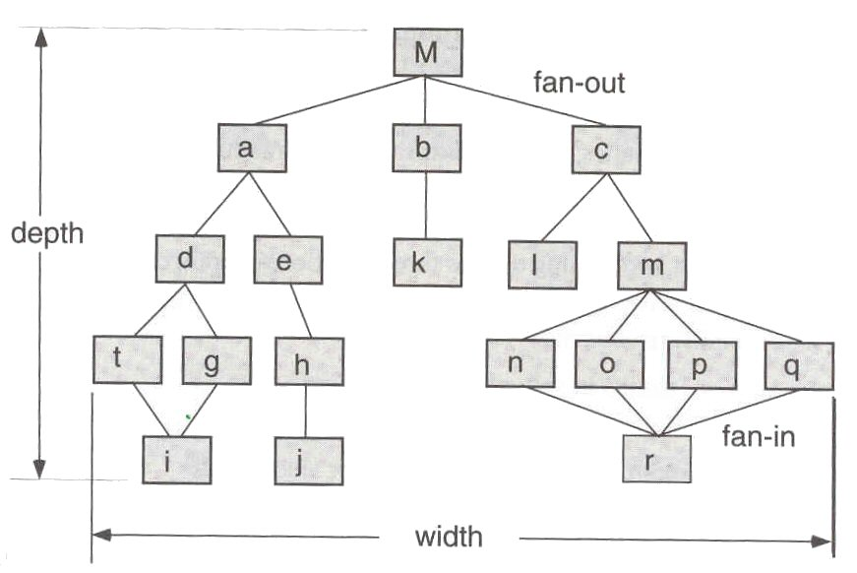
Control Terminology
Fig. 2 – Tree diagram

Slide 23
Control Terminology Cont’d
Span of control (number of levels of control within a software product)
Depth (distance between the top and bottom modules in program control structure)
Fan-out or width (number of modules directly controlled by a particular module)
Fan-in (number of modules that control a particular module
Visibility (set of program components that may be called or used as data by a given component)
Connectivity (set of components that are called directly or are used as data by a given component)
Notes:
Scope of effect of a module is defined as all the other modules that are affected by a decision made by that module. The scope of control of module ‘m’ is all the modules are subordinate to it i.e. ‘n’, ‘o’, ‘p’, ‘q’ and ‘r’
Visibility also refers to indirect connectivity

Slide 24
Modular Design Method Evaluation Criteria
Modular decomposability - provides systematic means for breaking problem into subproblems
Modular composability - supports reuse of existing modules in new systems
Modular understandability - module can be understood as a stand-alone unit
Notes:
The concept of modularity has been advocated for (5+) decades. In essence, the software is divided into separately named and addressable components called modules that are integrated to satisfy problem requirements. Motivation for this stems from the fact that a reader cannot easily grasp large programs comprised of a single module; the number of variables, control paths and sheer complexity would make understanding virtually impossible. Consequently, a modular approach would allow for the software to be intellectually manageable.
Note that one cannot subdivide software indefinitely to make the effort required to understand or develop it negligible. This is because as the number of increases (causing the effort to develop them to decrease), the effort (cost) of the associated integration process increases.

Slide 25
Modular Design Method Evaluation Criteria Cont’d
Modular continuity - side-effects due to module changes minimised
Modular protection - side-effects due to processing errors minimised
Notes:
The concept of modularity has been advocated for (5+) decades. In essence, the software is divided into separately named and addressable components called modules that are integrated to satisfy problem requirements. Motivation for this stems from the fact that a reader cannot easily grasp large programs comprised of a single module; the number of variables, control paths and sheer complexity would make understanding virtually impossible. Consequently, a modular approach would allow for the software to be intellectually manageable.
Note that one cannot subdivide software indefinitely to make the effort required to understand or develop it negligible. This is because as the number of increases (causing the effort to develop them to decrease), the effort (cost) of the associated integration process increases.

Slide 26
Effective Modular Design
Functional independence - modules have high cohesion and low coupling
  Cohesion - qualitative indication of the degree to which a module focuses on just one thing
  Coupling - qualitative indication of the degree to which a module is connected to other modules and to the outside world
Notes:
High Cohesion and Low coupling is the aim of modular design.

Slide 27
How do we design for effective modularity?
Evaluate the first iteration of the program structure to reduce coupling and improve cohesion.
Attempt to minimise structures with high fan-out; strive for fan-in as structure depth increases.
Keep the scope of effect of a module within the scope of control for that module.
Notes:
Heuristic = Common Sense Approach
Modules may be exploded (1 becomes 2 or more) or imploded to reduce coupling and improve cohesion.
Factoring – process of determining what properties and methods belong to a given module. Closely related properties/methods should be grouped together.

Slide 28
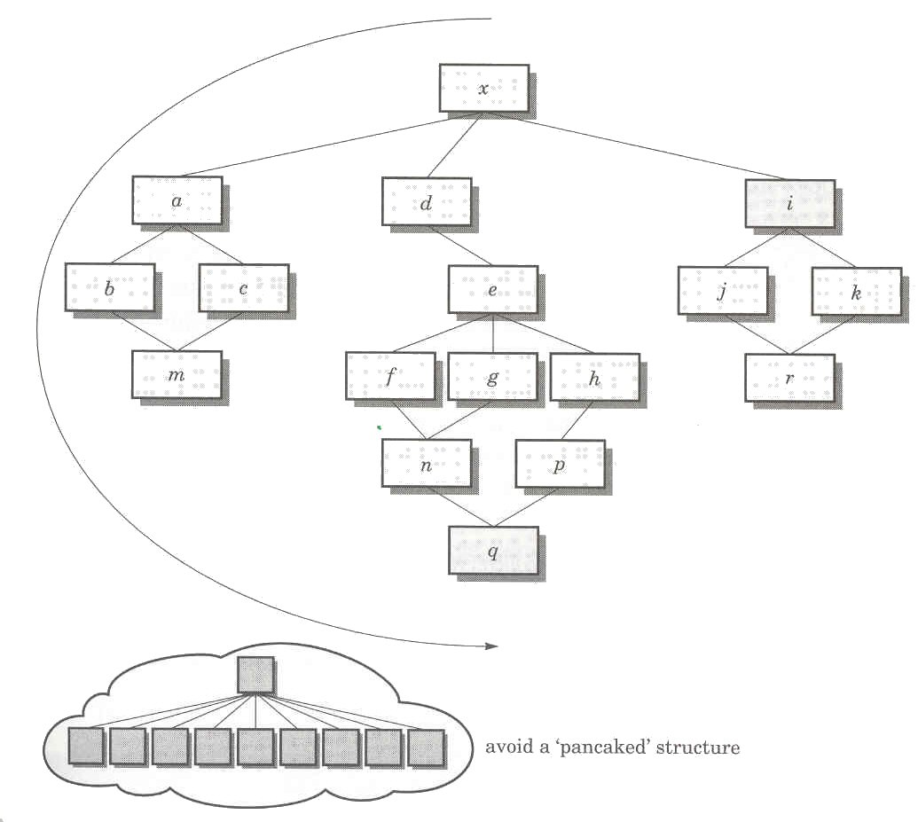
Program structure
Fig. 3 – Example of a program structure

Slide 29
How do we design for effective modularity cont’d?
Evaluate module interfaces to reduce complexity, reduce redundancy, and improve consistency.
Define modules whose function is predictable and not overly restrictive (e.g. a module that only implements a single task).
Strive for controlled entry modules, avoid pathological connection (e.g. branches into the middle of another module)

Slide 30
What are some of the fundamental software design concepts?
Software architecture - overall structure of the software components and the ways in which that structure provides conceptual integrity for a system
Control hierarchy or program structure - represents the module organization and implies a control hierarchy, but does not represent the procedural aspects of the software (e.g. event sequences)

Slide 31
What are some of the fundamental software design concepts cont’d?
Structural partitioning - horizontal partitioning defines three partitions (input, data transformations, and output); vertical partitioning (factoring) distributes control in a top-down manner (control decisions in top level modules and processing work in the lower level modules)

Slide 32
What are some of the fundamental software design concepts cont’d?
Data structure - representation of the logical relationship among individual data elements (requires at least as much attention as algorithm design)
Software procedure - precise specification of processing (event sequences, decision points, repetitive operations, data organization/structure)

Slide 33
What are some of the fundamental software design concepts cont’d?
Information hiding - information (data and procedure) contained within a module is inaccessible to modules that have no need for such information

Slide 34
What are quality factors
Once the design principles are applied properly, the design will exhibit quality factors:
  External quality factors such as speed, reliability, correctness and usability can be readily observed by the user
  Internal quality factors relate to technical quality more so than the quality of the design itself.

Slide 35
Testing During the Design Phase
The goal of testing in this phase is to ensure:
  that the specifications have been accurately and completely incorporated into the design
  the correctness of the design
A thoroughly tested design should:
  Be free of logical errors
  Have all the interfaces correctly defined
Notes:
The importance of testing during the phase is to ensure that all of the faults are detected before coding begins, as the cost of fixing these faults increases dramatically.
Testing at this stage is done via inspections similar to those during the specifications phase with the exception that the client is not represented at the inspection meeting. This will be covered later during the Verification and Validation section of the course.

Slide 36
Design Phase Metrics
Number of modules – crude way to determine the size of the target product
Module coupling and cohesion – measures the quality of the design
Number of design faults
Cyclomatic Complexity – Number of branches in a module
Module complexity –
  Module size *(fan-in * fan-out)²
Notes:
Research has show that the last metric is no better than the cyclomatic complexity

Slide 37
Activity
Suggest ways in which the user interface to an e-commerce system such as an online bookstore or music retailer might be adapted for users who have visual impairment or problems with muscular control.

Slide 38
Use the Quiz for a Quick Recap
Do you want a quick recap? Why not use the quiz?
  Use either the immediate feedback version
    Provides a correct or incorrect message response after each question
  Or, the non-immediate feedback version

Slide 39
In the design phase software specifications are transformed into data structures, system architecture, interfaces, and components.
Design Quiz
Question 1
A
True
B
False
Peek
Click Peek to lookup the answer in the notes.
Skip

Slide 40
Designs must be assessed for quality before being implemented.
Design Quiz
Question 2
A
True
B
False
Peek
Click Peek to lookup the answer in the notes.
Skip

Slide 41
Created by transforming the analysis information model into data structures required to implement the software
Design Quiz
Question 3
A
Interface design
B
Data design
C
Architectural design
D
Component-level design
Peek
Click Peek to lookup the answer in the notes.
Skip

Slide 42
______________ allows designers to focus on solving a problem without being concerned about irrelevant lower level details.
Design Quiz
Question 4
Click on _____________ to enter answer.
Peek
Click Peek to lookup the answer in the notes.
Skip

Slide 43
The set of program components that may be called or used as data by a given component is:
Design Quiz
Question 5
A
Connectivity
B
Visibility
A
Both of the above
B
None of the above
Peek
Click Peek to lookup the answer in the notes.
Skip

Slide 44
Congratulations
You have successfully completed the quiz
Click here to see your report card

Slide 45
Reflective Question
Do you spend enough time in the design phase of software development?

Slide 46
Conclusions
In this session the reader:
  Was exposed to design best practices
  Was introduced to design phase metrics
  Was also exposed to design specification models

Slide 47
References
Sommerville, Ian. 2004. Software Engineering. 7th ed. USA: Addison Wesley

